Slide 1
Day 01
Linux Device Driver Training
Presented by,
Ganavi M
Ganavigowda512@gmail.com

Slide 2
COMPUTER
A computer is an electronic device that processes data to perform tasks according to a set of instructions. It can take in information (input), process it, store it, and then produce results (output).
Computers can perform a wide range of tasks, from simple calculations to complex simulations, and they are used in various fields such as education, entertainment, business, and research.
A computer is a powerful tool that processes data and performs tasks based on user input and software instructions, making it an indispensable part of modern life.

Slide 3
COMPONENTS OF COMPUTER
CPU (Central Processing Unit): The CPU is like the brain of the computer. It performs calculations, executes instructions, and manages data flow.
Memory (RAM): RAM stands for Random Access Memory. It's like the computer's short-term memory. It stores data and instructions that the CPU needs to access quickly while the computer is running.
Storage (Hard Drive, SSD): Storage is like the computer's long-term memory. It holds all your files, programs, and the operating system even when the computer is turned off.
Input Devices: These are devices like keyboards, mousee, and touchscreens that allow you to give commands to the computer or input data into it.
Output Devices: These are devices like monitors, printers, and speakers that allow the computer to communicate with you. They display information or output the results of calculations.
Motherboard: This is like the foundation of the house. It's a circuit board that connects all the other components together, allowing them to communicate and work together.
Expansion Cards: These are add-ons to the motherboard. They can add extra functionality to the computer, like graphics cards for better visuals or network cards for connecting to the internet.

Slide 4
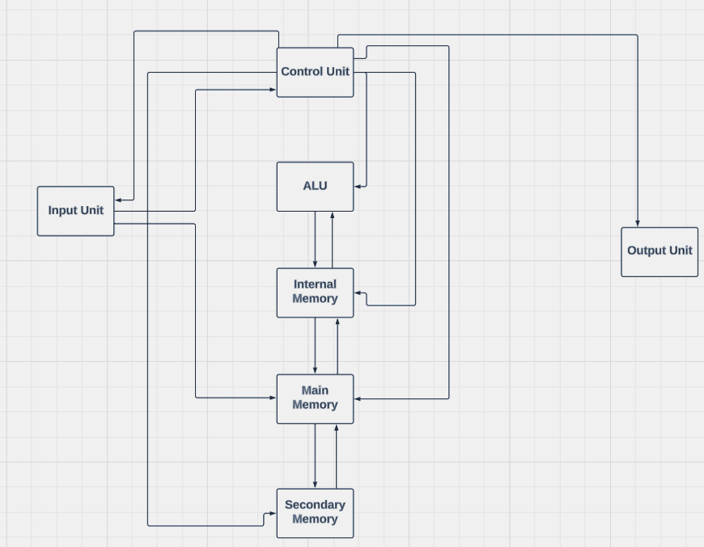
ARCHITECTURE
Input Unit: These are devices like keyboards and mouse where you give commands or input data to the computer.​
Control Unit: This component directs the flow of data and instructions within the CPU. It controls the operation of the ALU, memory, and other units within the CPU.​
ALU (Arithmetic Logic Unit): This is a part of the CPU responsible for performing arithmetic and logical operations, like addition, subtraction, and comparisons.​
Primary Memory (RAM): This is where the computer stores data and instructions that the CPU needs to access quickly while the computer is running. It acts as the computer's short-term memory.

Slide 5
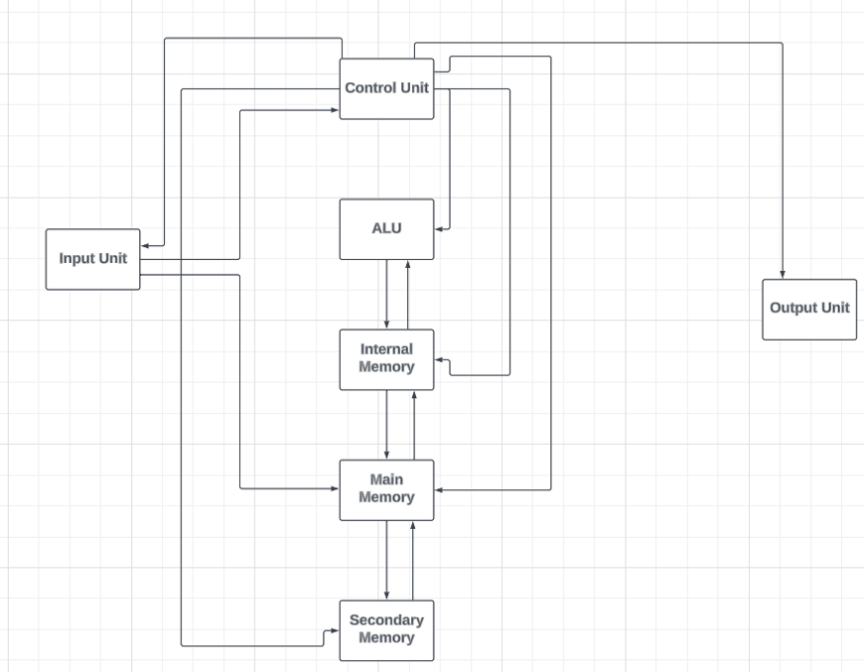
5. Secondary Memory (Storage): This includes storage devices like hard drives and SSDs. They store data and instructions even when the computer is turned off, acting as the computer's long-term memory.
6. Output Devices: These are devices like monitors and printers where the computer displays or outputs the results of its calculations or processes.
7. Internal Memory: This refers to the storage within the computer system itself, including caches and registers used for high-speed data storage and retrieval.

Slide 6
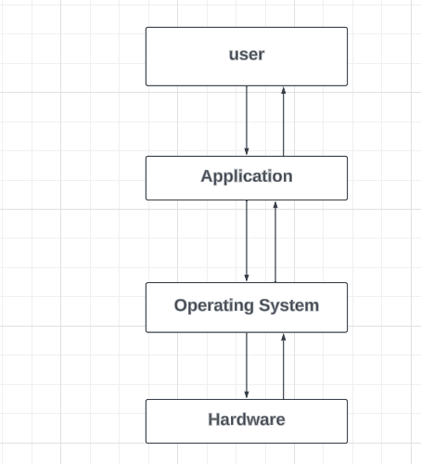
User: the person using the computer.
Operating System (OS): The software that manages the computer's resources and allows you to run programs and interact with the hardware.
Hardware: The physical components of the computer, like the processor (CPU), memory (RAM), storage devices (hard drive, SSD), input devices (keyboard, mouse), and output devices (monitor, printer).
Software/Applications: Programs and applications that you use on the computer, like web browsers, word processors, games, etc.

Slide 7
RISC And CISC
RISC (Reduced Instruction Set Computing):
RISC is like doing simple tasks one after the other. Each task is basic, but you may need to do more of them. It's like building something with simple blocks, one at a time. Complex operations may require multiple instructions.
CISC (Complex Instruction Set Computing):
CISC is like doing complex tasks all at once. Each task can be complicated, but you only need one instruction to do it or the tool that can do many things in a single move. CISC aims to reduce the number of instructions needed to accomplish a task. Single instructions can perform multiple low-level operations.

Slide 8
BUS STRUCTURE
The bus structure is like a highway system inside a computer that connects different components and allows them to communicate with each other. It consists of electrical pathways (called buses) that transmit data, addresses, and control signals between components like the CPU, memory, and peripherals.
Components
Address Bus: Carries signals that specify memory locations or addresses.
Data Bus: Transfers data between the CPU, memory, and peripherals.
Control Bus: Manages the flow of data and control signals between components.
When a component needs to read or write data, it sends the appropriate address and control signals through the address and control buses. The data is then transferred through the data bus. This allows for efficient and simultaneous communication between multiple components.

Slide 9
Benefits
Buses allow multiple components to share the same pathway, which improves efficiency and reduces the number of connections needed.​
They enable different components to communicate with each other, allowing for modular and expandable computer systems.​
Buses provide a straightforward and standardized method for connecting components, making computer design and assembly easier.​
Drawbacks
Bandwidth Limitation: The bandwidth of a bus can become a bottleneck as more components share it, limiting overall system performance.​
Latency: Buses introduce delays in data transmission, especially when multiple components are accessing the bus simultaneously.​
Limited Scalability: As the number of components increases, the bus may become overloaded, leading to decreased performance and system instability.​

Slide 10
RAM
SRAM (Static Random Access Memory):
SRAM is like a small, fast storage area. It's fast but needs more space and power. It's used in things like cache memory because of its high speed and low access time.
DRAM (Dynamic Random Access Memory):
DRAM is like a bigger, slower storage area. It's slower but more space-efficient and uses less power. It's used as the main memory in computers. DRAM holds the majority of the data and instructions needed by the CPU for executing programs. It is slower compared to SRAM but offers larger storage capacities at a lower cost.
CACHE MEMORY
Cache memory is like a small, super-fast storage area that's kept close to the main processor in a computer. It holds onto the most frequently used data and instructions, so the processor can access them quickly without having to go all the way to the slower main memory. It's managed automatically by the computer to make sure it has the most important stuff ready when needed.
Example: Web browsers use cache memory to store website data, such as HTML, CSS, and images, to improve page loading times and provide a smoother browsing experience. Mobile apps often utilize cache memory to store frequently accessed user data, such as profile information and recently viewed content, allowing for faster retrieval and offline access.

Slide 11
MOORE'S LAW
Moore's Law is a principle in the field of computer science and electronics, proposed by Gordon Moore, the co-founder of Intel Corporation, in 1965. It states that the number of transistors on a microchip (or integrated circuit) doubles approximately every two years, while the cost of the microchip remains constant or decreases.
Transistors are tiny electronic switches that form the building blocks of computer chips. They perform the basic logic and memory functions in electronic devices.
As time goes on, computer chips can contain more and more transistors, allowing for greater processing power and capabilities.
Despite the increasing complexity and performance of chips, Moore's Law also suggests that the cost of manufacturing these chips should remain relatively constant or even decrease over time.

Slide 12
PIPELINING
Pipelining is a technique used in computer processors to improve their efficiency by overlapping the execution of multiple instructions. in pipelining, a processor breaks down the execution of instructions into smaller stages (like fetching, decoding, executing, and storing). Instead of waiting for one instruction to complete before starting the next, the processor starts executing multiple instructions simultaneously by having each stage work on a different instruction. This overlap in execution helps improve the overall speed and efficiency of the processor.
Ganavi M

Slide 13
Thank you

